Slide 1
Systems Analysis and Design
Dr. Taysir Hassan Abdel Hamid
Office no. 226 (2nd Floor)
Information systems Department
taysirhs2@gmail.com
Office hours:
Wednesday 12-2

Slide 2
Book Name
Alan Dennis, Barbara Haley Wixom, and Roberta Roth. System Analysis and Design. John Wiley & Sons, Inc. 5th Edition, 2006. (Chapters 1-6, 8-15)
Gary B. Shelly, Thomas J. Cashman, and Harry J. Rosenblatt. Systems Analysis and Design. Thomson Course Technology, 7th Edition, USA, 2008. (Chapters 1,2 + cases + questions)

Slide 3
Grading Scheme
Final Exam: 70 points
Year Work (Assignments): 20 points
Midterm Exam: 10 points

Slide 4
Lectures Schedule

Slide 5
Projects
You can choose the project you want to work on.
Work group is from the same section
Work group is from 4-7 students

Slide 6
Course Outline
Introduction to Systems Analysis and Design
SDLC
Applying SDLC into a real-life problem

Slide 7
The Systems Development Life Cycle (SDLC)
The SDLC is composed of four fundamental phases:
  Planning …
  Analysis …
  Design …
  Implementation …

Slide 8
To Understand the SDLC:
  Each phase consists of steps that lead to specific deliverables
  The system evolves through gradual refinement

Slide 9
Phase I: Planning
This phase is the fundamental process of understanding why an information system should be built.
The Planning phase will also determine how the project team will go about building the information system.
The Planning phase is composed of two planning steps.

Slide 10
Two Planning Steps
During project initiation, the system’s business value to the organization is identified (How will it lower costs or increase revenues?)
During project management, the project manager creates a work plan, staffs the project, and puts techniques in place to help the project team control and direct the project through the entire SDLC.

Slide 11
Planning
Project initiation:
Deliverables: System Request, Feasibility Study
Project management:
Deliverable: WorkPlan

Slide 12
Phase II: Analysis
The analysis phase answers the questions of who will use the system, what the system will do, and where and when it will be used.
During this phase the project team investigates any current system(s), identifies improvement opportunities, and develops a concept for the new system.
This phase has three analysis steps.

Slide 13
Three Analysis Steps
Analysis strategy: This is developed to guide the projects team’s efforts. This includes an analysis of the current system.
Requirements gathering: The analysis of this information leads to the development of a concept for a new system. This concept is used to build a set of analysis models.
System proposal: The proposal is presented to the project sponsor and other key individuals who decide whether the project should continue to move forward.

Slide 14
The system proposal is the initial deliverable that describes what business requirements the new system should meet.
The deliverable from this phase is both an analysis and a high-level initial design for the new system.

Slide 15
Phase III: Design
In this phases it is decided how the system will operate, in terms of:
  hardware,
  software, and
  network infrastructure;
  the user interface, forms, and reports that will be used;
  and the specific programs, databases, and files that will be needed.

Slide 16
Five Design Steps
Design Strategy: This clarifies whether the system will be developed by the company or outside the company.
Architecture Design: This describes the hardware, software, and network infrastructure that will be used.
Database and File Specifications: These documents define what and where the data will be stored.
Program Design: Defines what programs need to be written and what they will do.

Slide 17
Phase IV: Implementation
During this phase, the system is either developed or purchased (in the case of packaged software).
This phase is usually the longest and most expensive part of the process.
The phase has three steps.

Slide 18
Three Implementation Steps
System Construction: The system is built and tested to make sure it performs as designed.
Installation: Prepare to support the installed system.
Support Plan: Includes a post-implementation review.

Slide 19
Systems Development Methodologies
A methodology is a formalized approach to implementing the SDLC.
The methodology will vary depending on whether the emphasis is on businesses processes or on the data that supports the business.

Slide 20
Process-centered Methodologies
With this methodology, the focus is on defining the activities associated with the system.
The concentration is on representing the system concept as a set of processes with information flowing into and out of the processes.

Slide 21
Data-centered Methodologies
This methodology focuses on defining the content of the data storage containers and how they are organized.
Data-centered methodologies utilize data models as the core of the system concept.

Slide 22
Object-oriented Methodologies
This methodology attempts to balance the focus between processes and data.
The Unified Modeling Language (UML) is used to describe the system concept as a collection of objects incorporating both data and processes.

Slide 23
Category I of the System Development Methodology: Structured Design
Structured design methodologies adopt a formal step-by-step approach to the SDLC that moves logically from one phase to the next.
This design methodology introduces the use of formal modeling or diagramming techniques to describe a system’s basic business processes and follows a basic approach of two structured design categories.

Slide 24
Waterfall Development
With waterfall development- based methodologies, the analysts and users proceed sequentially from one phase to the next.
The two key advantages of waterfall development-based methodologies are:
- The system requirements are identified long before programming begins.
- Changes to the requirements are minimized as the project proceeds.

Slide 25
The two key disadvantages of waterfall development-based methodologies are:
- The design must be completely specified before programming begins.
- A long time elapses between the completion of the system proposal in the analysis phase and the delivery of the system.

Slide 26
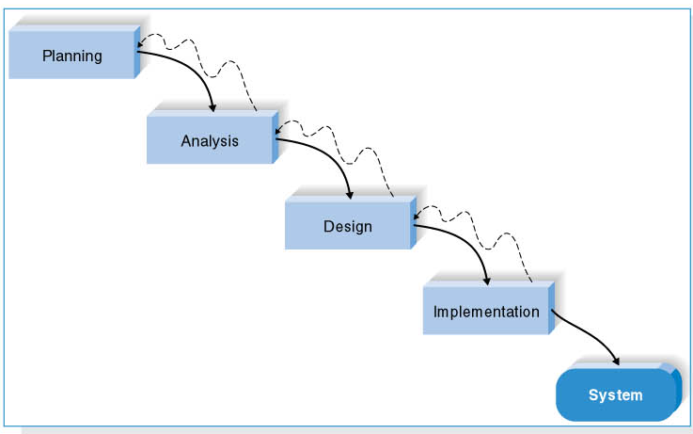
Waterfall Development-based Methodology

Slide 27
Parallel Development
This methodology attempts to address the long time interval between the analysis phase and the delivery of the system.

Slide 28
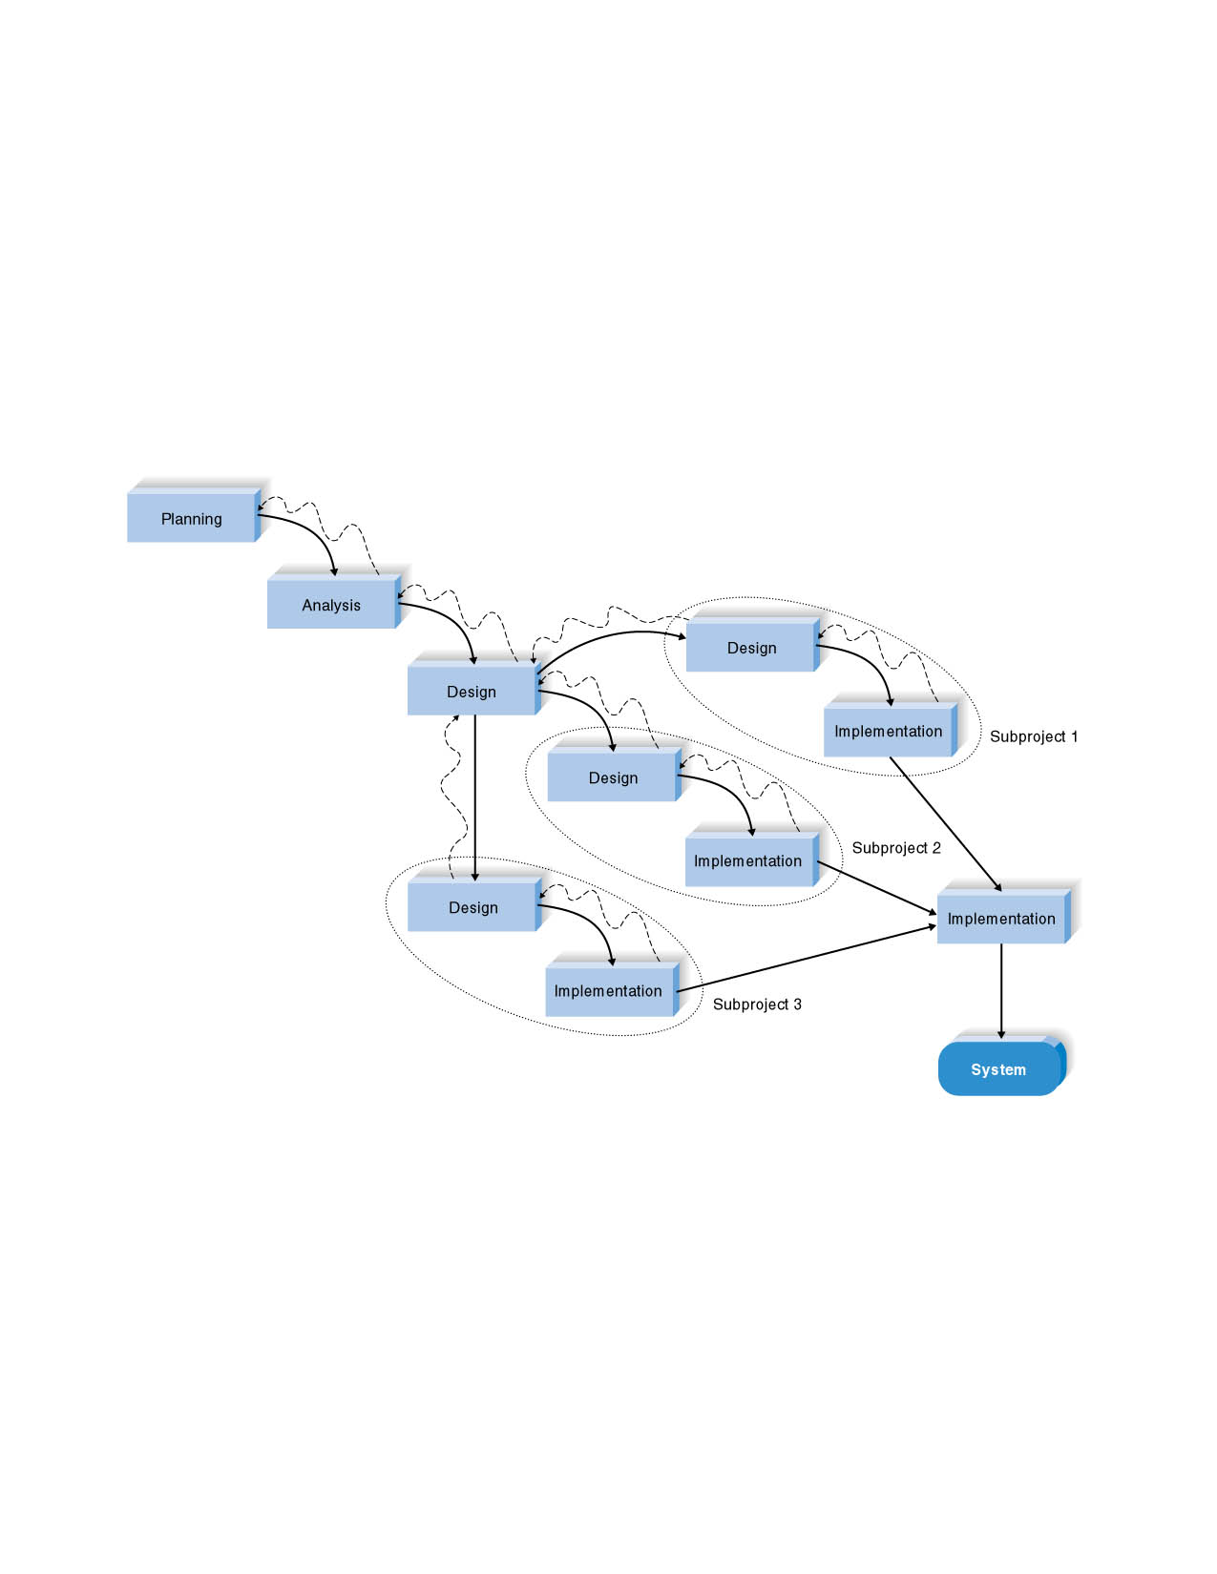
A general design for the entire system is performed and then the project is divided into a series of distinct subprojects.

Slide 29
Category II of the System
Development Methodology: Rapid Application Development (RAD)
RAD-based methodologies adjust the SDLC phases to get some part of system developed quickly and into the hands of the users.
Most RAD-based methodologies recommend that analysts use special techniques and computer tools to speed up the analysis, design, and implementation phases, such as CASE (computer-aided software engineering) tools.

Slide 30
Phased Development
This methodology breaks the overall system into a series of versions that are developed sequentially.
The team categorizes the requirements into a series of versions, then the most important and fundamental requirements are bundled into the first version of the system.
The analysis phase then leads into design and implementation; however, only with the set of requirements identified for version 1.
As each version is completed, the team begins work on a new version.

Slide 31
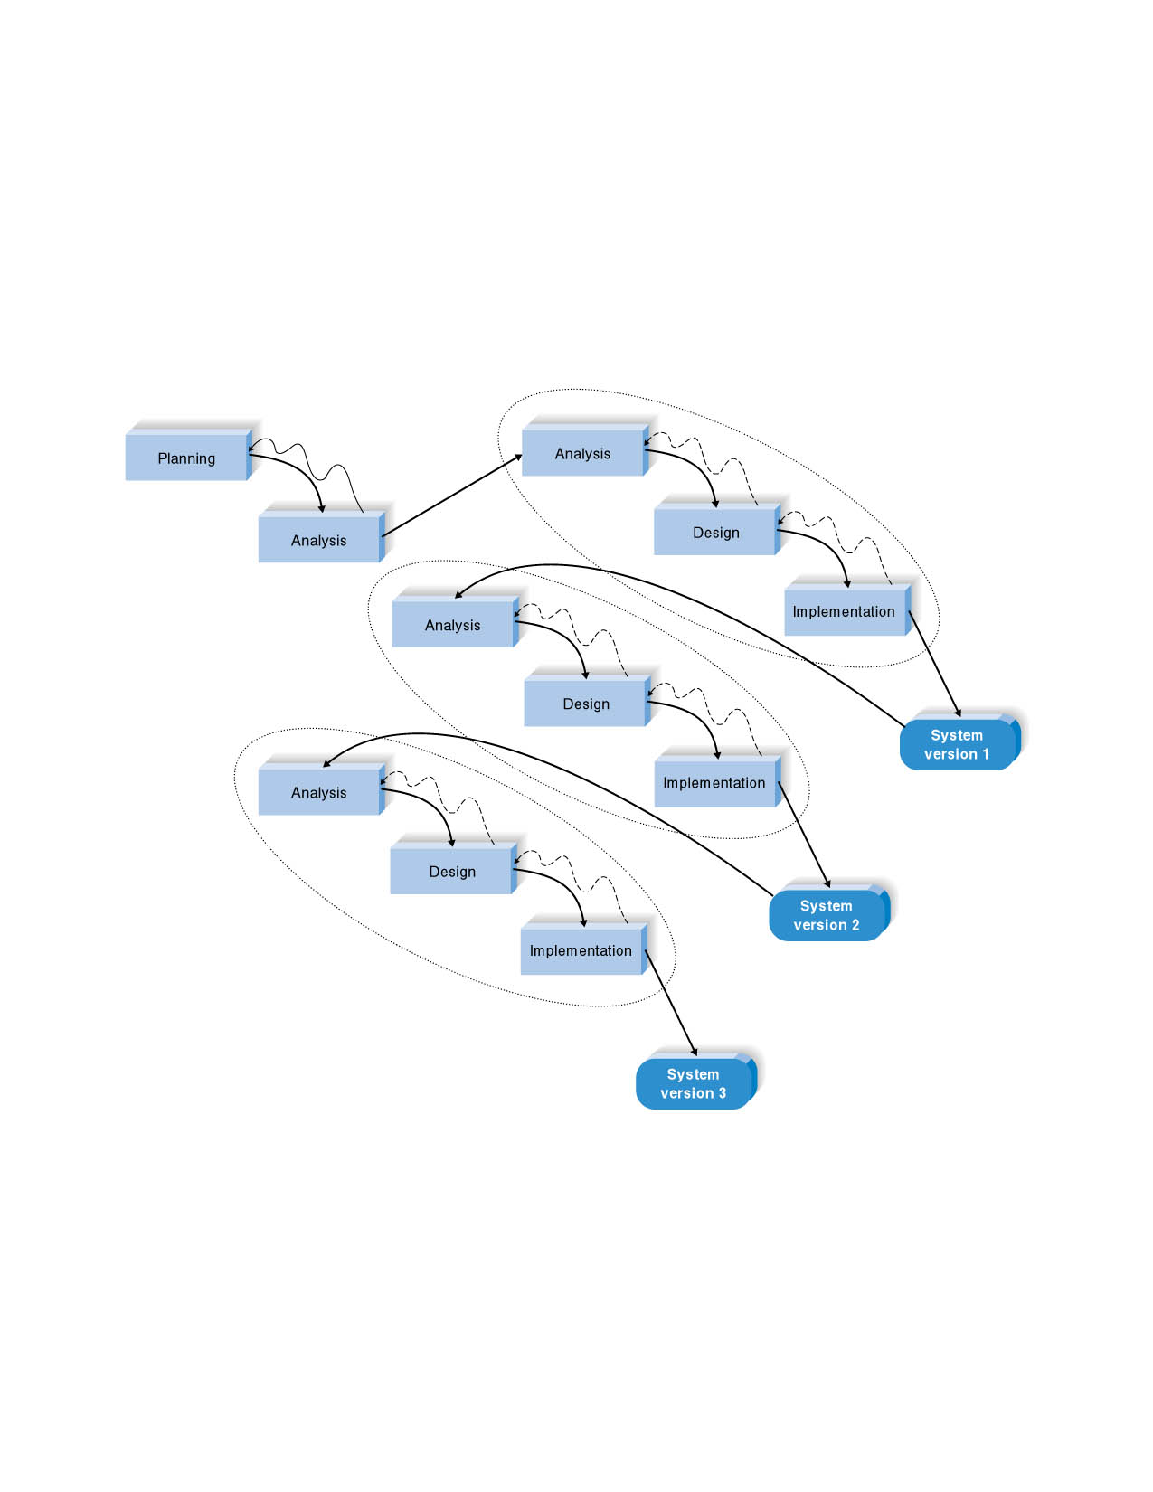
Phased Development-based Methodology

Slide 32
Prototyping
Prototyping-based methodologies perform the analysis, design and implementation phases concurrently.
All three phases are performed repeatedly in a cycle until the system is completed.
A prototype is a smaller version of the system with a minimal amount of features.

Slide 33
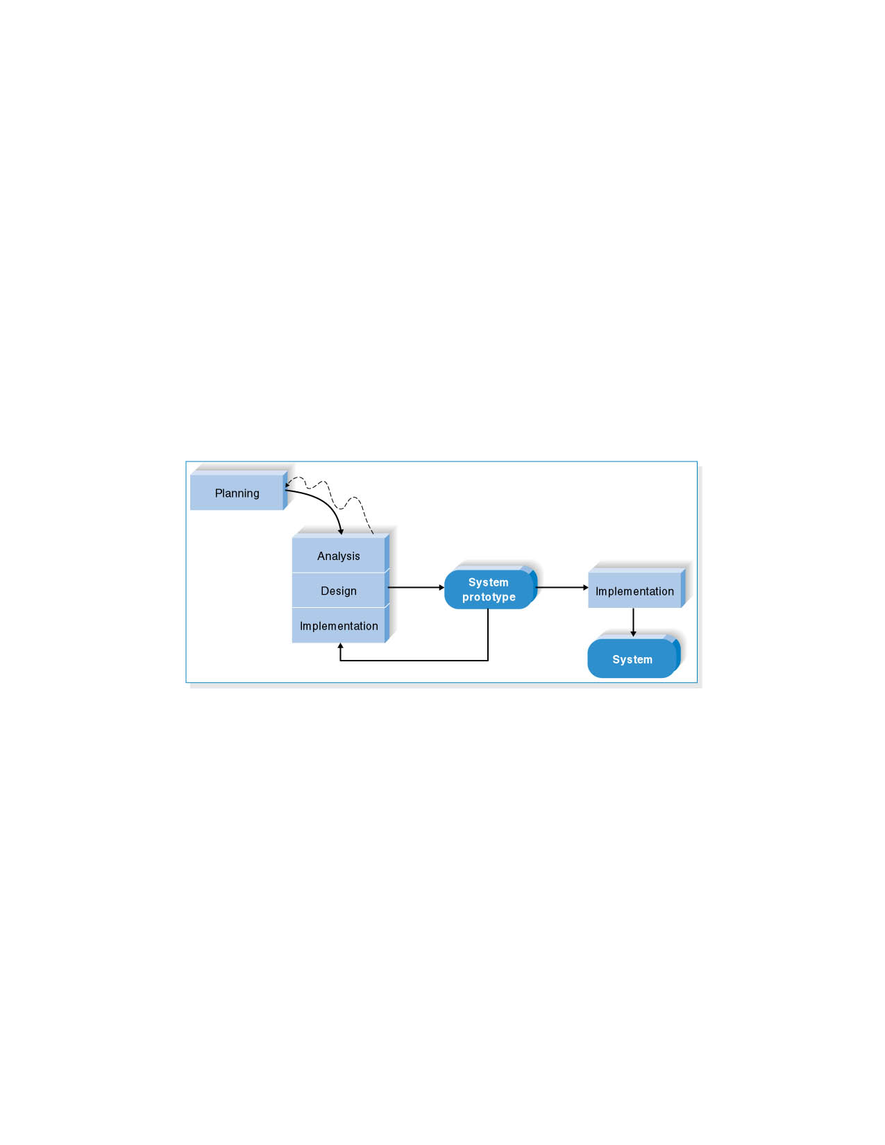
Prototyping-based Methodology

Slide 34
Advantage: Provides a system for the users to interact with, even if it is not initially ready for use.
Disadvantage: Often the prototype undergoes such significant changes that many initial design decisions prove to be poor ones.

Slide 35
Throwaway prototyping methodologies are similar to prototyping based methodologies.
The main difference is that throwaway prototyping IS completed during a different point in the SDLC.
Has relatively thorough analysis phase.

Slide 36
Category III of the System
Development Methodology: Agile Development
This category focuses on streamlining the SDLC by eliminating much of the modeling and documentation overhead and the time spent on those tasks.
Projects emphasize simple, iterative application development.
This category uses extreme programming, which is described next.

Slide 37
Extreme Programming (XP)
Extreme Programming (XP) was founded on four core values:
  Communication
  Simplicity
  Feedback
  Courage

Slide 38
Key principles of XP include:
  Continuous testing
  Simple coding
  Close interaction with the end users to build systems very quickly

Slide 39
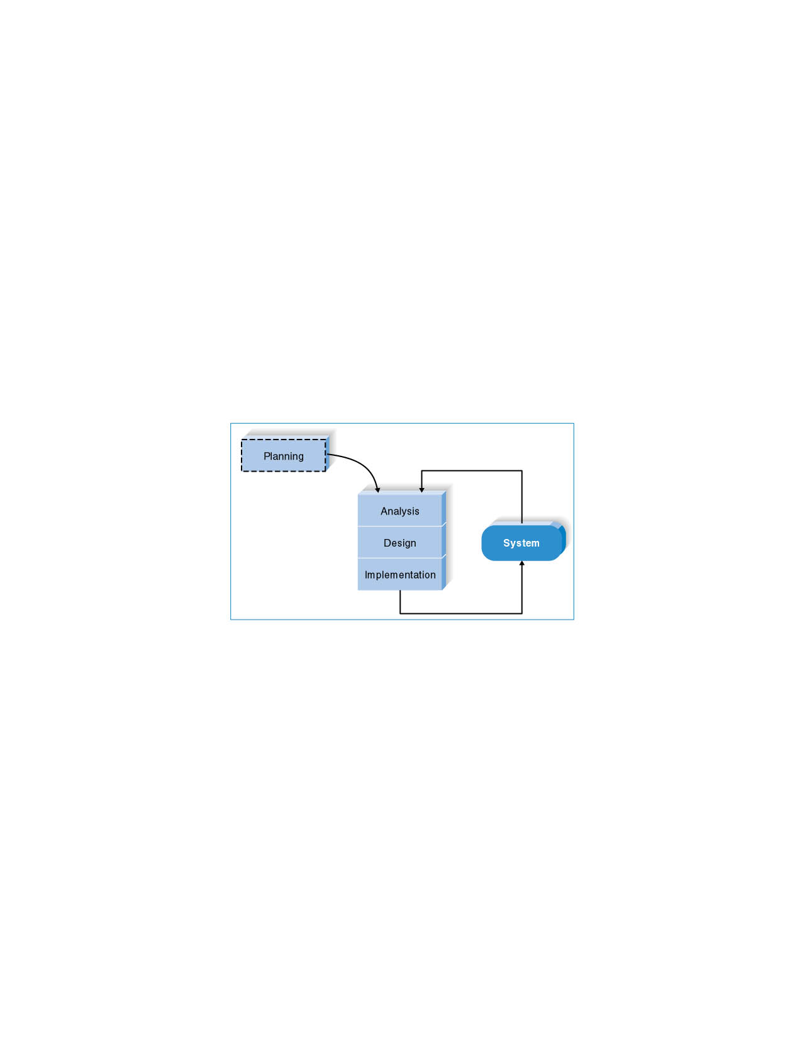
An Extreme Programming-based Methodology

Slide 40
Selecting the Appropriate Development Methodology
Selecting a methodology is not simple, as no one methodology is always best.
Many organizations have their own standards.
The next figure summarizes some important methodology selection criteria.

Slide 41
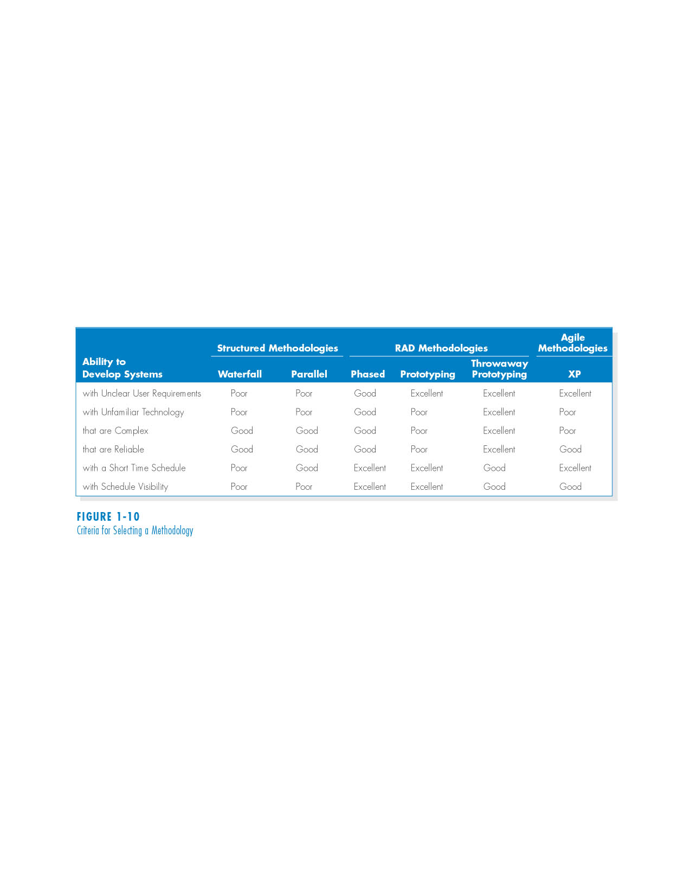
Criteria for Selecting a Methodology

Slide 42
Clarity of User Requirements
RAD methodologies of prototyping and throwaway prototyping are usually more appropriate when user requirements are unclear as they provide prototypes for users to interact with early in the SDLC.

Slide 43
Familiarity with Technology
If the system is designed without some familiarity with the base technology, risks increase because the tools may not be capable of doing what is needed.

Slide 44
System Complexity
Complex systems require careful and detailed analysis and design.
Project teams who follow phased development-based methodologies tend to devote less attention to the analysis of the complete problem domain than they might if they were using other methodologies.

Slide 45
System Reliability
System reliability is usually an important factor in system development.
Throwaway prototyping-based methodologies are most appropriate when system reliability is a high priority.
Prototyping-based methodologies are generally not a good choice as they lack careful analysis and design phases.

Slide 46
Short Time Schedules
RAD-based methodologies are well suited for projects with short time schedules as they increase speed.
Waterfall-based methodologies are the worst choice when time is essential as they do not allow for easy schedule changes.

Slide 47
Schedule Visibility
RAD-based methodologies move many of the critical design decisions earlier in the project; consequently, this helps project managers recognize and address risk factors and keep expectations high.

Slide 48
Project Team Skills and Roles
Projects should consist of a variety of skilled individuals in order for a system to be successful.
Six major skill sets an analyst should have include:
  Technical
  Business
  Analytical
  Interpersonal
  Management
  Ethical

Slide 49
Categories of Analysts
Business Analyst
Systems Analyst
Infrastructure Analyst
Change Management Analyst
Project Manager

Slide 50
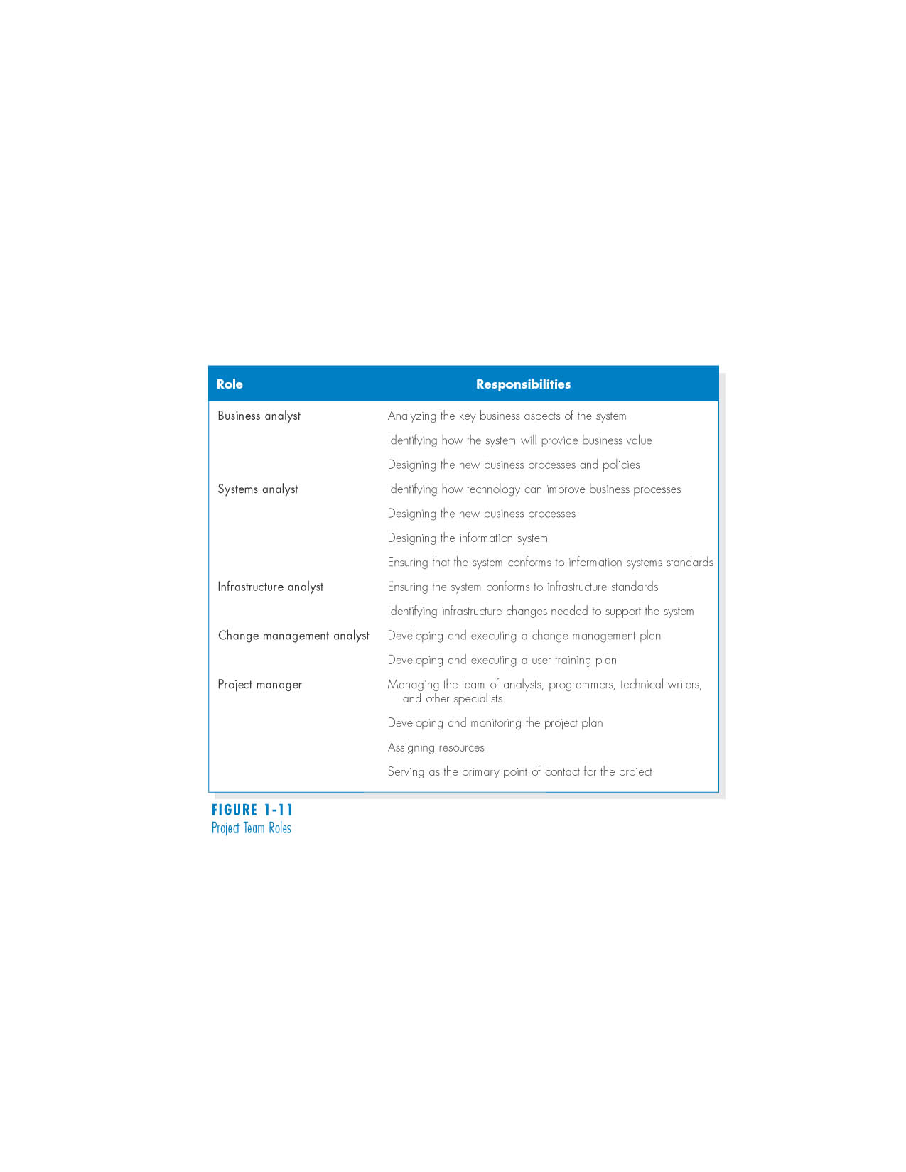
Project Team Roles

Slide 51
Summary
The Systems Development Lifecycle consists of four stages: Planning, Analysis, Design, and Implementation
There are six major development methodologies: the waterfall method, the parallel development method, the phased development method, system prototyping, design prototyping, and agile development.
There are five major team roles: business analyst, systems analyst, infrastructure analyst, change management analyst and project manager.

Slide 52
Copyright © 2006
John Wiley & Sons, Inc.
All rights reserved. Reproduction or translation of this work beyond that permitted in Section 117 of the 1976 United States Copyright Act without the express written permission of the copyright owner is unlawful.
Request for further information should be addressed to the Permissions Department, John Wiley & Sons, Inc.
The purchaser may make back-up copies for his/her own use only and not for redistribution or resale.
The Publisher assumes no responsibility for errors, omissions, or damages, caused by the use of these programs or from the use of the information contained herein.

